Slide 1

Red Black Trees
Lecture 6

Slide 2
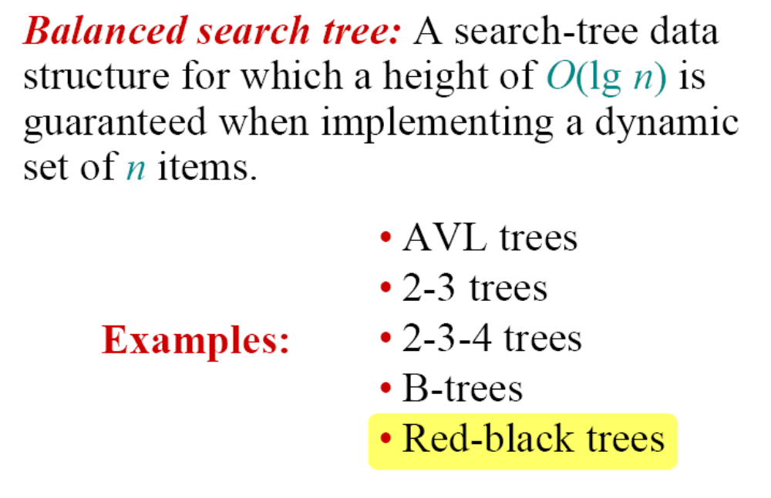
Balanced search trees

Slide 3
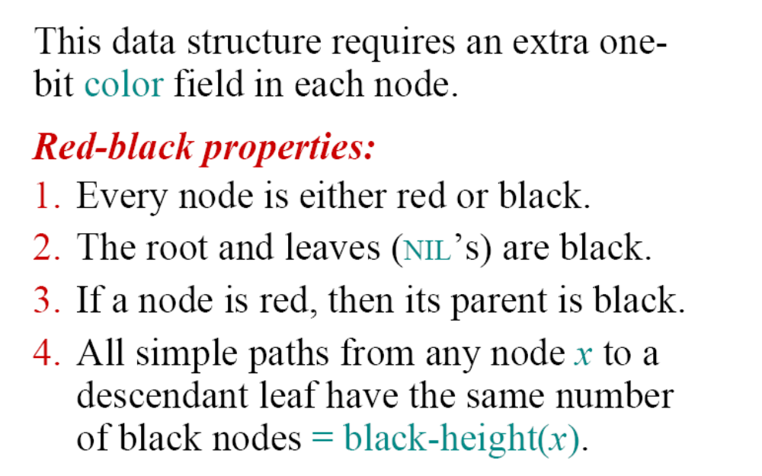
Red-black trees

Slide 4
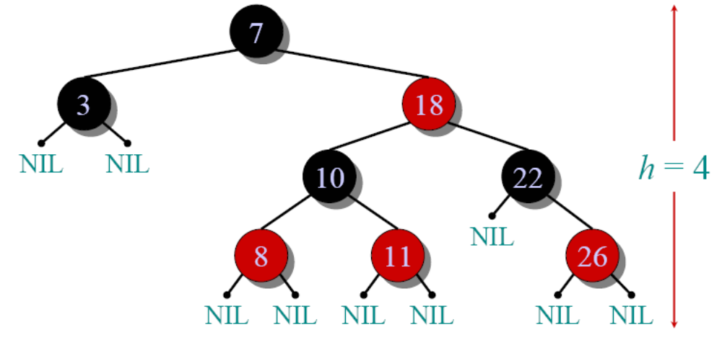
Example of a red-black tree

Slide 5
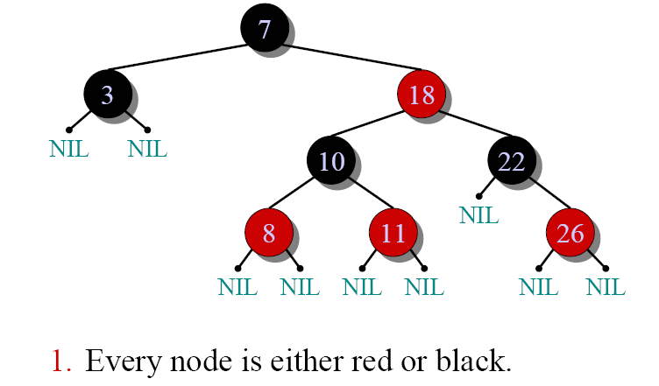
Example of a red-black tree

Slide 6
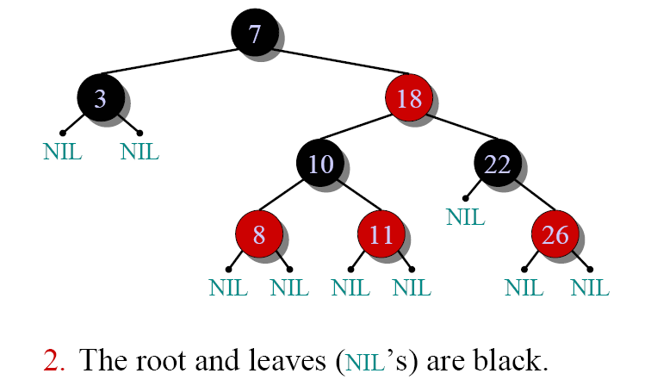
Example of a red-black tree

Slide 7
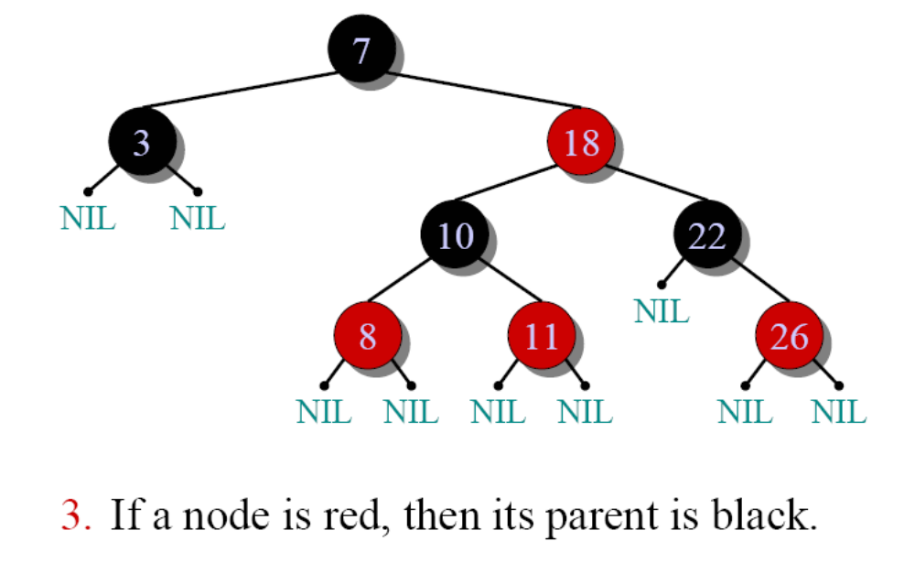
Example of a red-black tree

Slide 8
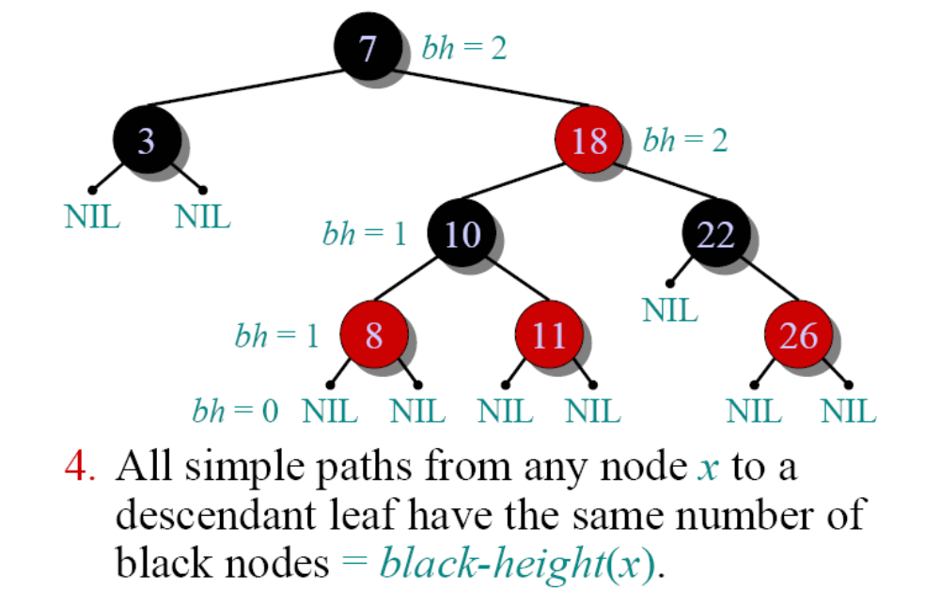
Example of a red-black tree

Slide 9
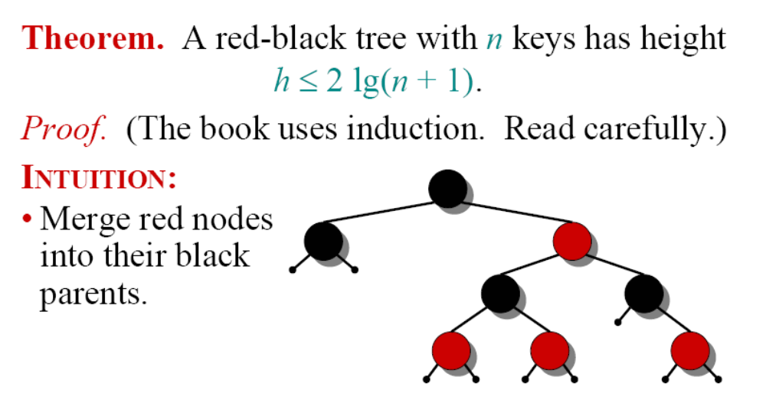
Height of a red-black tree

Slide 10
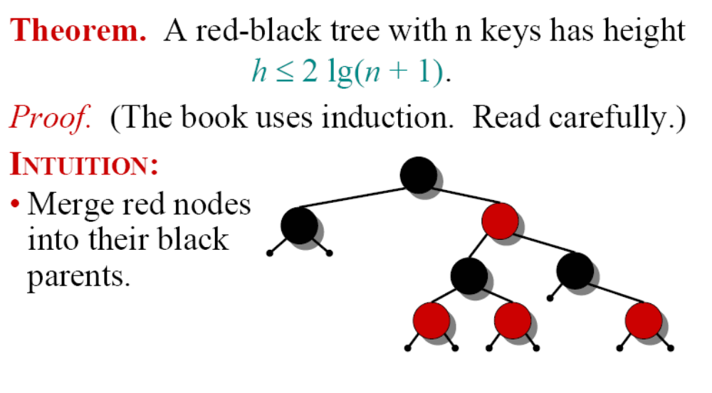
Height of a red-black tree

Slide 11
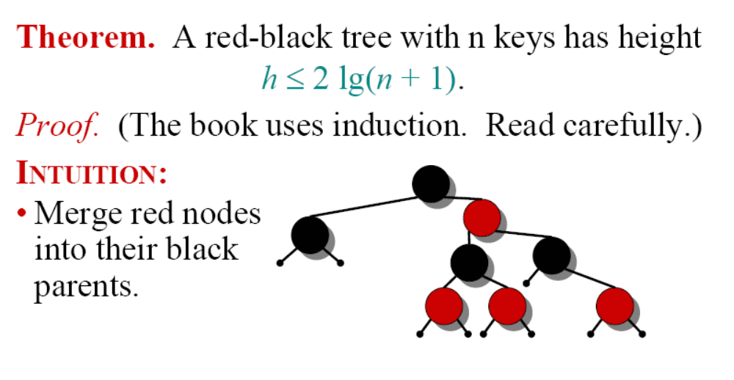
Height of a red-black tree

Slide 12
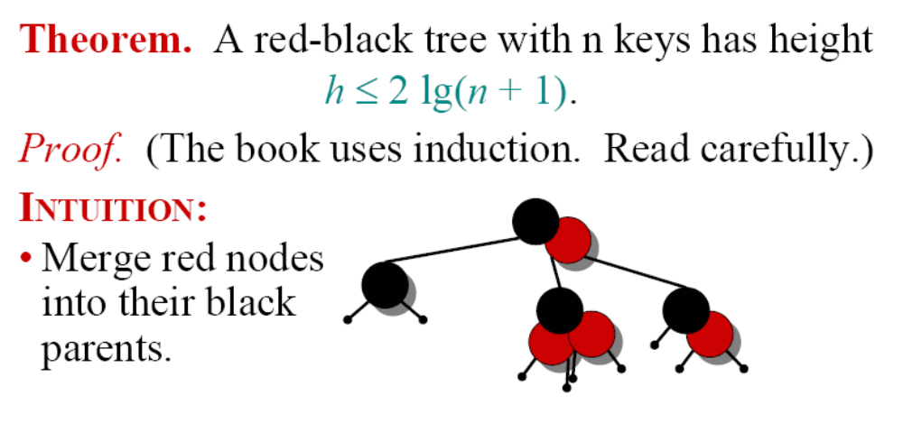
Height of a red-black tree

Slide 13
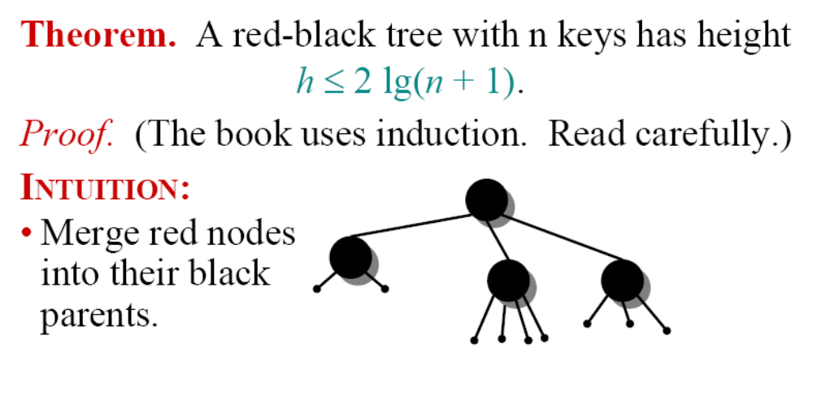
Height of a red-black tree

Slide 14
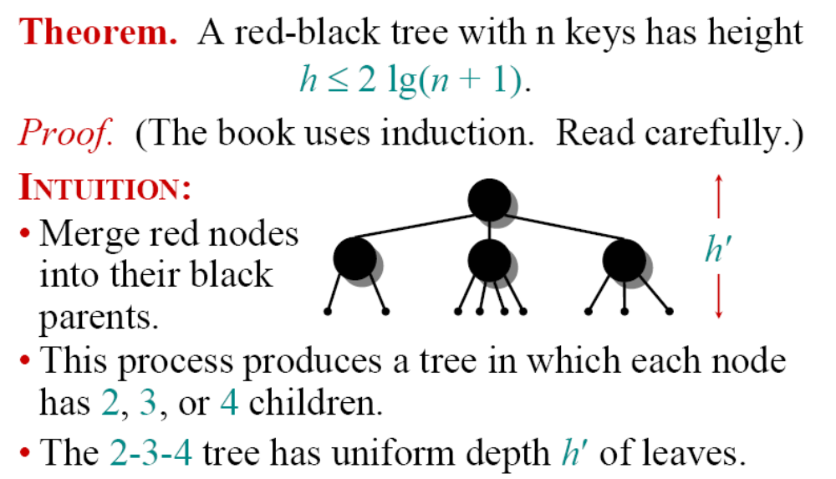
Height of a red-black tree

Slide 15
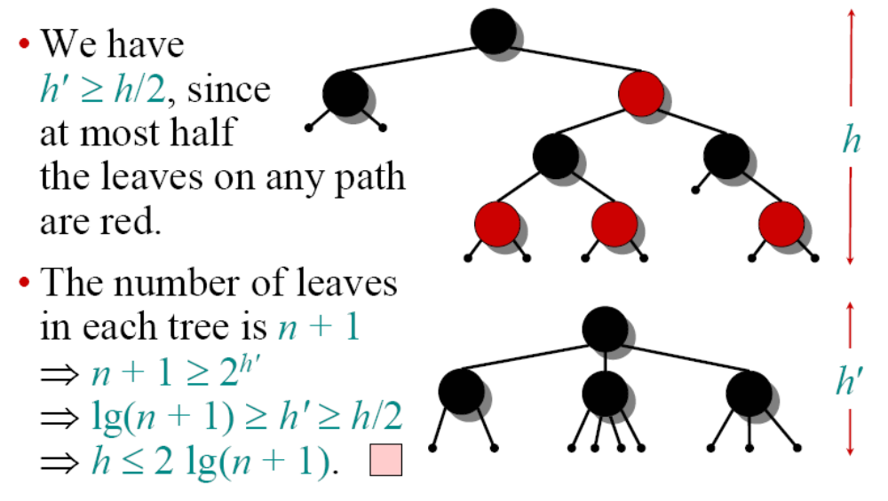
Proof (continued)

Slide 16
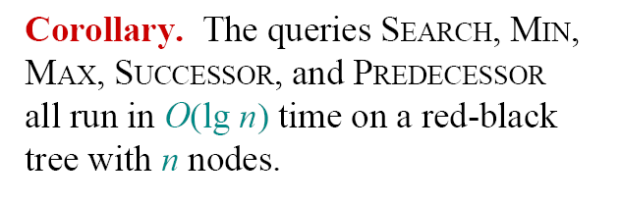
Query operations

Slide 17
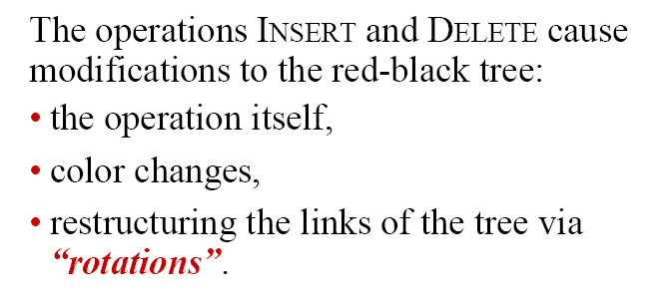
Modifying operations

Slide 18
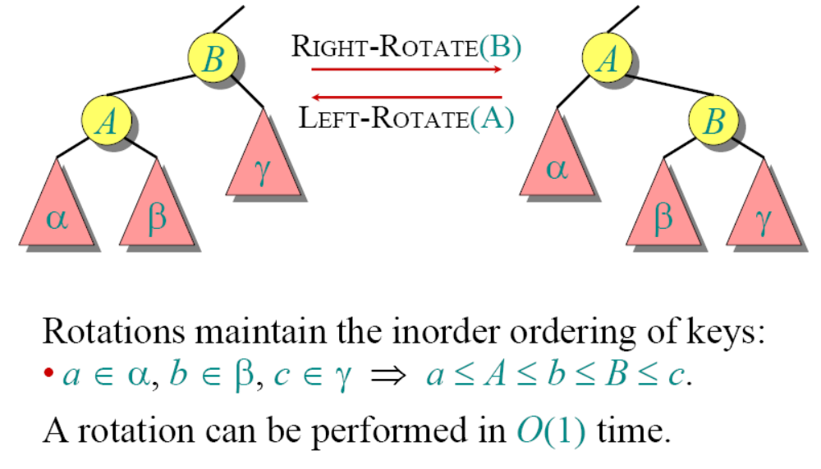
Rotations

Slide 19
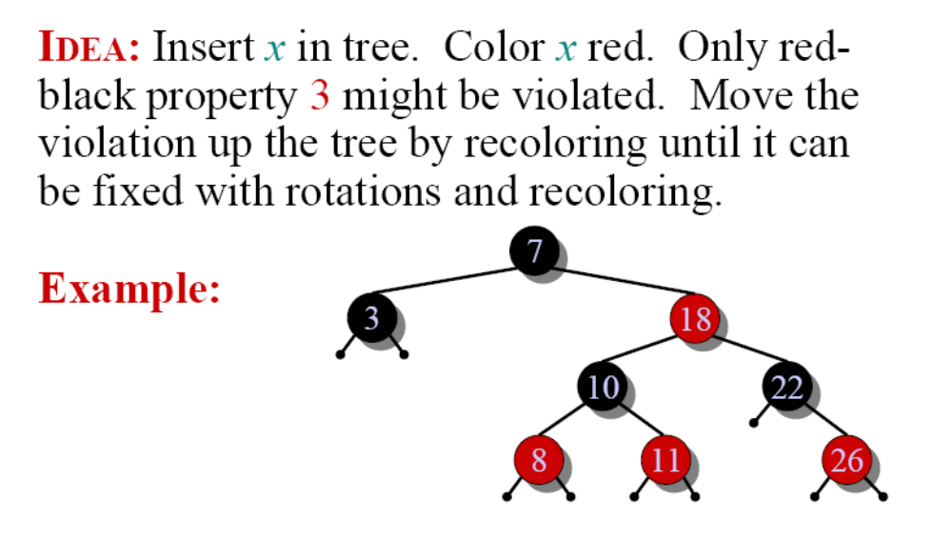
Insertion into a red-black tree

Slide 20
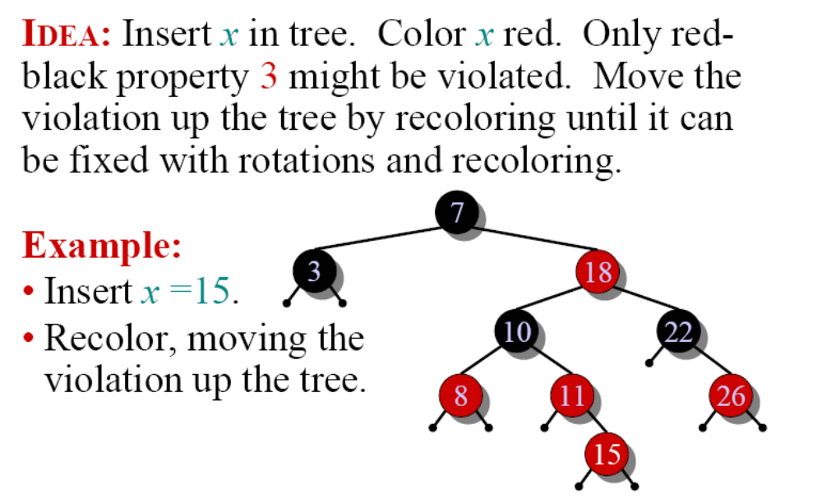
Insertion into a red-black tree

Slide 21
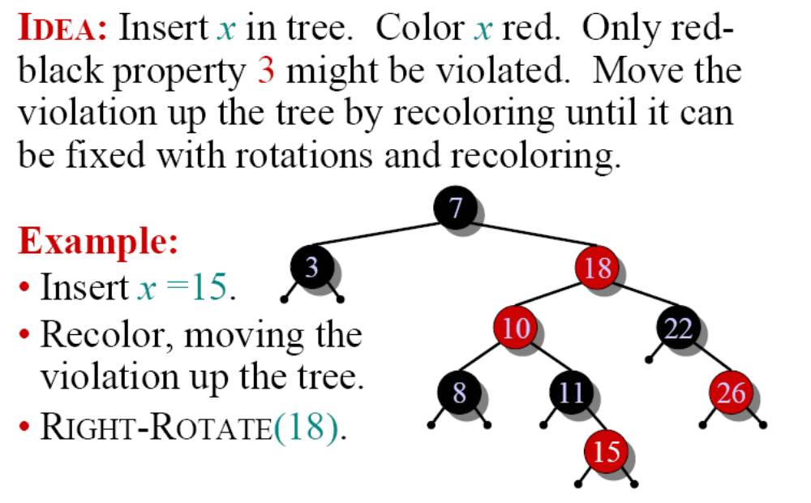
Insertion into a red-black tree

Slide 22
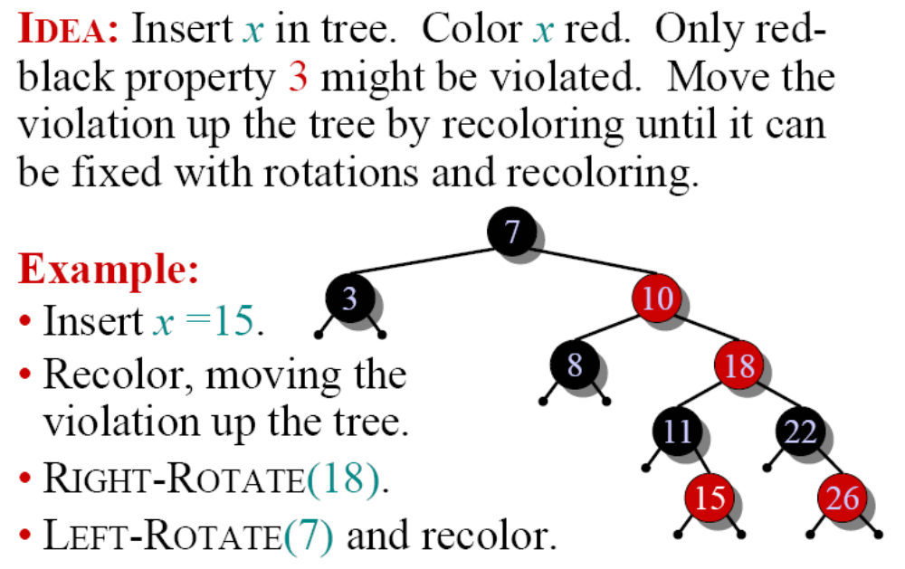
Insertion into a red-black tree

Slide 23
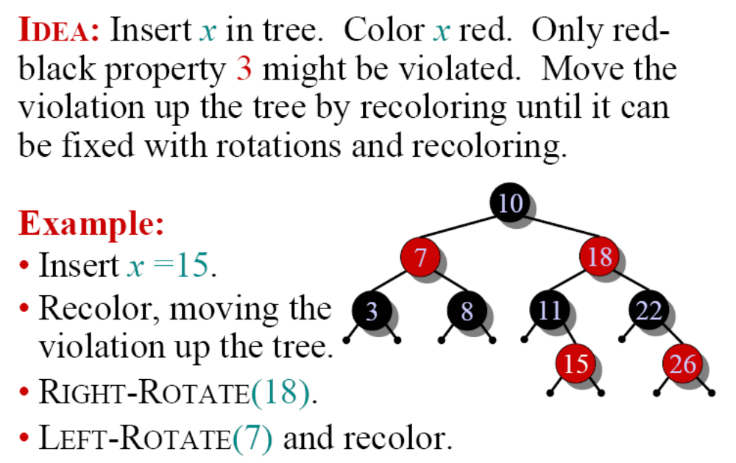
Insertion into a red-black tree

Slide 24
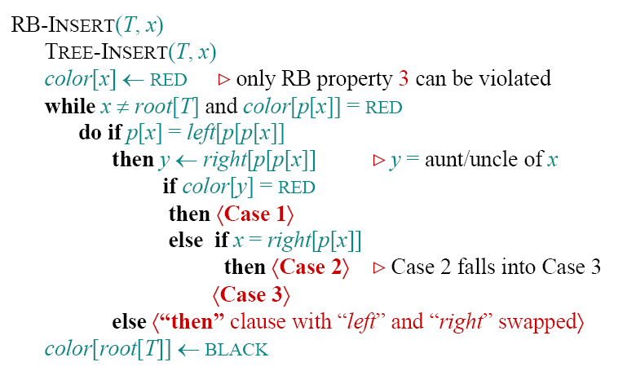
Pseudocode

Slide 25
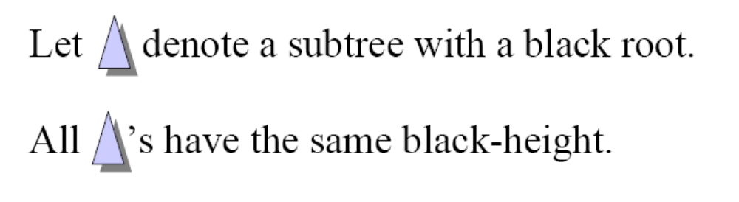
Graphical notation

Slide 26
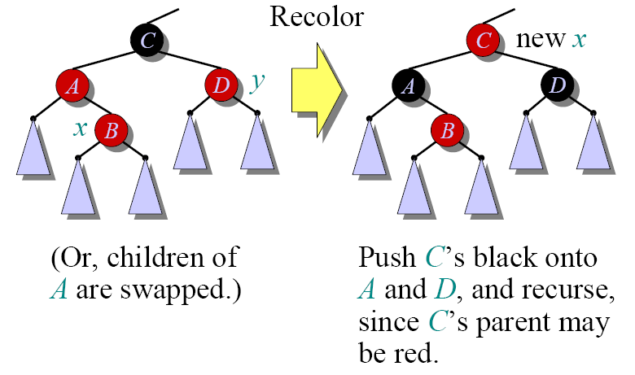
Case 1

Slide 27
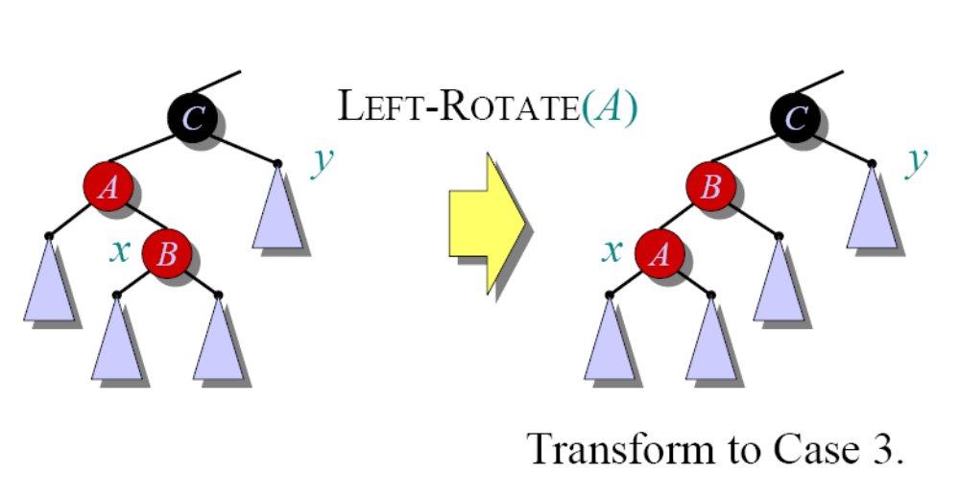
Case 2

Slide 28
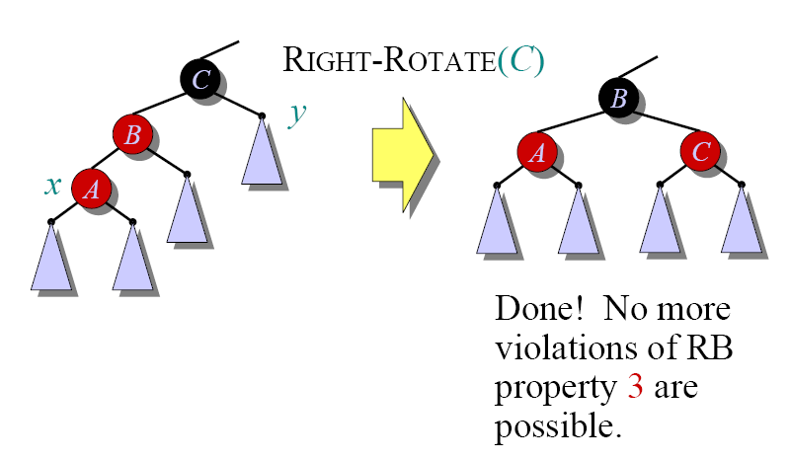
Case 3

Slide 29
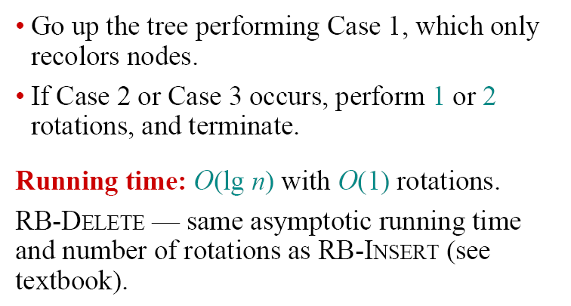
Analysis

